Slide 1

Slide 1
Grocery Outlet
K-means
clustering
Febin varghese

Slide 2
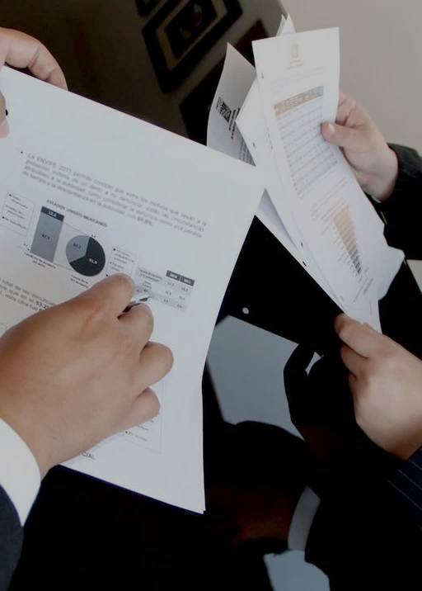
Slide 6
Subclass level
Top 8 subclasses with most transaction
46,9126 transactions

Slide 3

Elbow Method For Optimal k
K=11
With help of Elbow method
I choose optimal number for k=11
k

Slide 4
Clusters
clusters | % of Transactions
1 | 9%
2 | 1%
3 | 32%
4 | 2%
5 | 7%
6 | 12%
7 | 5%
8 | 14%
9 | 6%
10 | 11%
11 | 1%

Slide 5


Average price spend on each cluster
clusters | mean
1 | 9.78
2 | 14.78
3 | 2.19
4 | 25.68
5 | 7.44
6 | 8.9
7 | 11.7
8 | 6.4
9 | 11.38
10 | 9.34
11 | 916.25

Slide 6
VEGETABLES 45%
BANANAS 14%
MISCELLANEOUS PRODUCE 11%
BERRIES 9%
POULTRY - 8%
CEREAL (COLD) 5%
DAIRY GALLONS 5%
YOGURT SINGLE SERVE 2%
K=3

Slide 7
YOGURT SINGLE SERVE 50%
BANANAS 14%
CEREAL (COLD) 8%
BERRIES 7%
VEGETABLES 7%
MISCELLANEOUS PRODUCE 6%
DAIRY GALLONS 5%
POULTRY 4%
K=8

Slide 8
BERRIES 51%
BANANAS 17%
VEGETABLES 8%
MISCELLANEOUS PRODUCE 8%
CEREAL (COLD) 6%
DAIRY GALLONS 5%
POULTRY 4%
YOGURT SINGLE SERVE 2%
K=6

Slide 9
MISCELLANEOUS PRODUCE 49%
BANANAS 17%
VEGETABLES 9%
BERRIES 8%
CEREAL (COLD) 6%
DAIRY GALLONS 5%
POULTRY - RDW 4%
YOGURT SINGLE SERVE 2%
K=1

Slide 10

Slide 10
THANK YOU

Slide 11
Slide 10
QUESTIONS?

